Slide 1

Visvesvaraya Technological University BelAgaVI 590014
MACHINE LEARNING BASED ANESTHESIA CONTROLLING SYSTEM FOR MEDICAL APPLICATIONS
Submitted By
Anuradha Dixit (1DT18EC015)
Chaitra B P (1DT18EC027)
Jalla Swathika (1DT18EC036)
Kavya A J (1DT19EC406)by
Under the Guidance of
Dr. SUMAIYA M N
(Associate Professor, Dept. of ECE)
BATCH: A2 (31/05/2022)
Department of Electronics and Communication Engineering
DAYANANDA SAGAR ACADEMY OF TECHNOLOGY AND MANAGEMENT
Udayapura, Kanakapura Road, Bangalore-560082
2021-2022

Slide 2
OUTLINE:
INTRODUCTION
LITERATURE SURVEY
PROBLEM STATEMENT
OBJECTIVES
BLOCK DIAGRAM
METHODOLOGY
SOFTWARE AND HARDWARE USED
PROJECT IMPLEMENTATIONS
EXPERIMENTAL RESULTS
PERFORMANCE MEASURES/QUALITY METRICS
CONCLUSION AND FUTURE SCOPE
REFERENCES

Slide 3


INTRODUCTION:
Major operations are performed to remove or reconstruct the infected parts
in the human body. These operations will lead to blood loss and pain.
Therefore, it is necessary to arrest the pain and the blood loss.
Anesthesia plays an important role in the part of painkilling.
Anesthesia is a state of control, temporary hearing loss or awareness implanted for
medical purposes
In the event of major surgery which may take 4 or 5 hours, anesthesia is given in mutltiple dose to a patient in some preffered amount as well as interval.

Slide 4
LITERATURE SURVEY:
Sl. No. | Title and Author | Journal and Year | Observations | Take Away Points
1) 2) 3) | Microcontroller Based Anaesthesia Injector by: Srinivasa Naidu N, Kavya Sai M, Meghana PVS, Sai Praneeth M Manoj Kalyan Design of Arduino based Automatic Anesthetic Drug Injector by: Pooja G H, Dr. Shubhangi D C, Prof. Baswaraj Gadgay Machine-Learning Rule-based Fuzzy Logic Control for Depth of Anesthesia by: D.A Linkens, J.S. Shieh and J.E. Peacock | Journal of Applied Science and Computations-April 2019 International Research Journal of Engineering and Technology (IRJET)- August 2021 IEEE Journal of The University of Sheffield, U.K. 2019 | * Keypad provides the doctor to enter the amount of anesthesia and delay time for the next dose. * Real time clock keeps track of current time. * Stepper motor injects uniform flow of anesthesia * Here DC gear motor is used for the long time operations because of its more rotations. * Since they have used many sensors (bleeding detection sensor, heartbeat and breathing sensor), here ATMEGA-328 is used which has EEPROM. *The machine-learning rule-base for PDOA has been shown to be very similar to the anesthetists's rule-base in the clinical trials. *A hierarchical rule-based fuzzy logic control for depth of anesthesia which is similar to the way an anesthetist works has also been developed in this paper. | * 125 steps of stepper motor rotation is required to inject 1ml of drug when the delay provided to stepper motor between each pulse is 6000 microseconds and the step angle is 1.8 degrees (i.e. full step). * The user interface is very easy, so it makes the interfacing with user lot easier and it can be used in much number of surgeries this makes very less use of Technology. *The rule base validation for the drug controller is acceptable when compared with clinical trials.

Slide 5
4) 5) | Application of the Information Management &Quality Control System Software for Anaesthesia Department by: Hongliang Zhu, Hongguang Bao, Hongwei Shi, Lei Xu Robust Predictive Control Strategy Applied for Propofol Dosing Using BIS as a Controlled Variable During Anesthesia by: Clara M. Ionescu | IEEE 2020 second international conference on information and computing science IEEE transactions on biomedical engineering, sepetember-2018 | *To enhance the anesthesia management, utilize information resources efficiently and control anesthesia quality, we have independently developed the *Information Management System for Anesthesia Department, which could process record, search and statistics on information and data. This paper presents the application of predictive control to drug dosing during anesthesia in patients undergoing surgery. | *“Information Edition” provides editing function for various information forms and databases. *Many pull-down menus exist in the anesthetist input module, with their contents in responding information forms, to be modified by departments based on their own conditions. The EPSAC_MPC performance can be improved by adding an adaptive gain scheduling in the first 200’s of the anesthesia by varying the sigmoid curve based on the real feedback data (BIS monitor).

Slide 6

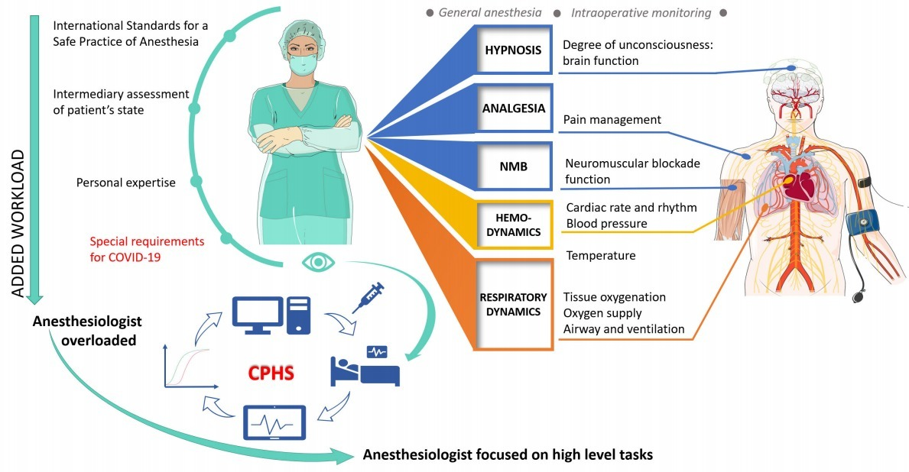
PROBLEM STATEMENT
The quality of life of patients is totally dependent on the
doctors who are prone to make mistakes, mistakes or
errors are ok if there is no life or death situation.
The anesthetists handle not one surgery every day but they
handle multiple surgeries back to back as it’s their job so the chances
are more to commit errors.
So Embedded patient monitoring system has been designed
with different sensors to give alert to anesthesiologist if any
abnormality occurs while delivering anesthesia to the patient.

Slide 7
objectives
The main aim of the project is to aid an anesthetist during a surgery to eliminate human errors in injecting precise amount of anesthesia drug to the patient.
Keypad is interfaced to set the level of anesthesia to be administered to the patient in terms of milliliters (1ml to 1000ml) and the time at which the drug should be injected.
LCD is interfaced to display the quantity to be injected and the time at which the drug is to be injected. Real time clock keeps a track of current time.
Stepper motor is mechanically connected to the syringe infusion pump injects uniform flow of anesthesia at desired time.
The training dataset allows the machine to analyze and learn the associations between an input and desired output.

Slide 8
BLOCK DIAGRAM
x
KEYPAD
LCD
ML Data Sets
Arduino UNO
Peristaltic Motor
Motor Driver
Power Supply
Input
Output
Power Supply

Slide 9
methodology
Power Supply
By using the keypad provided along with the Microcontroller, the anesthetist can set the level of anesthesia to be administered to the patient in terms of milliliters (1ml to 1000ml).
After receiving the anesthesia level from the keypad, the Microcontroller sets the system to administer anesthesia to the prescribed level.
The rotation of the stepper motor causes the Infusion Pump to move in forward or in a backward direction and the anesthesia provided in the syringe will be injected into the body of the patient.
IR detector is included in the present system for monitoring the total anesthesia level throughout surgery period.
The training dataset allows the machine to analyze and learn the associations between an input and desired output and if there is any problem occurs in patient’s body then it is displayed in the LCD.
LCD Display
Patient Number
Activate Peristaltic Motor
Inject Anesthesia
Output

Slide 10
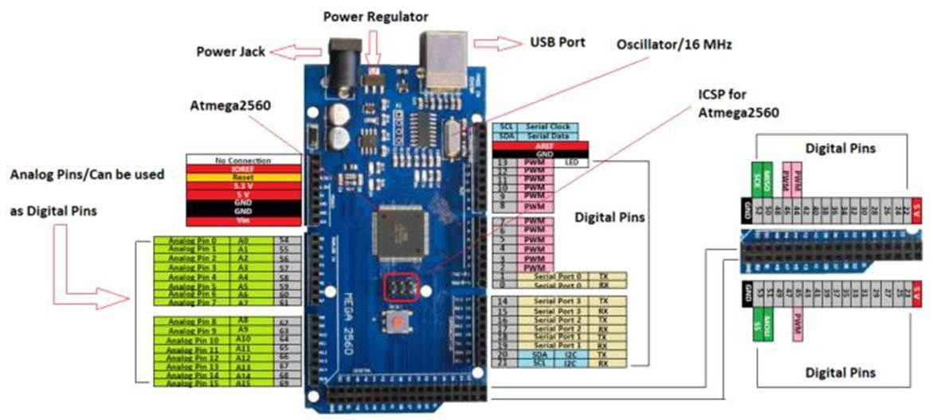
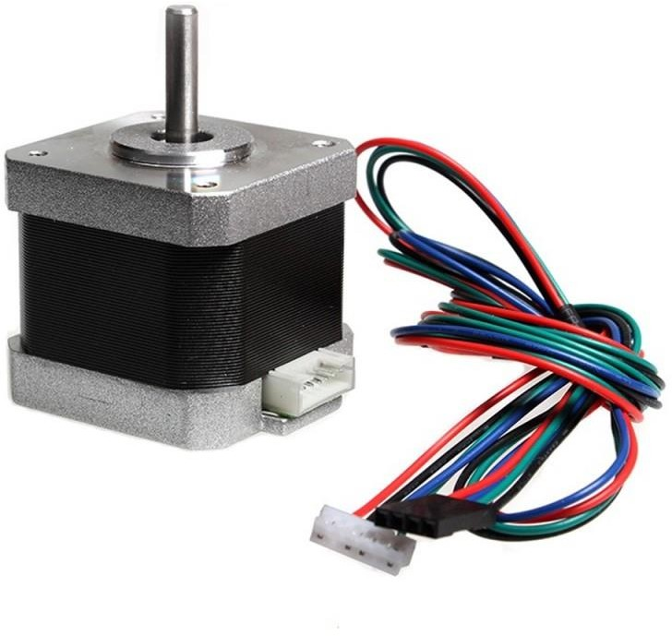
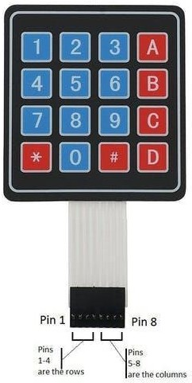
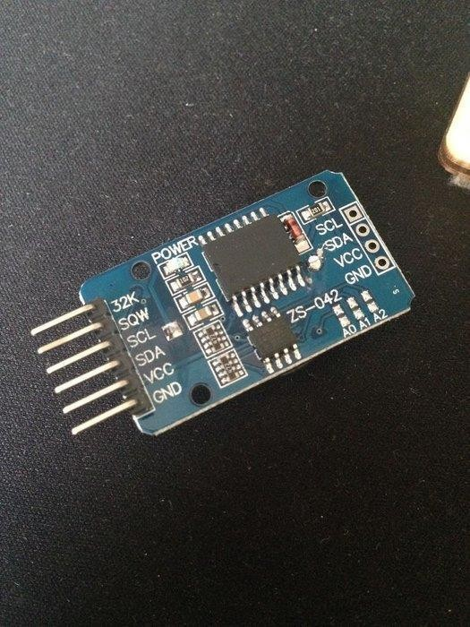
SOFTWARE AND HARDWARE USED
HARDWARE COMPONENTS:
Micro-Controller – to Control the overall operation (ARDUINO UNO)
Liquid Crystal Display (16*2)*I2C
Keypad (4*4)
Peristaltic Motor, Motor Driver(L298)
Different Sensors
SOFTWARE USED: Machine learning and Arduino UNO IDE

Slide 11
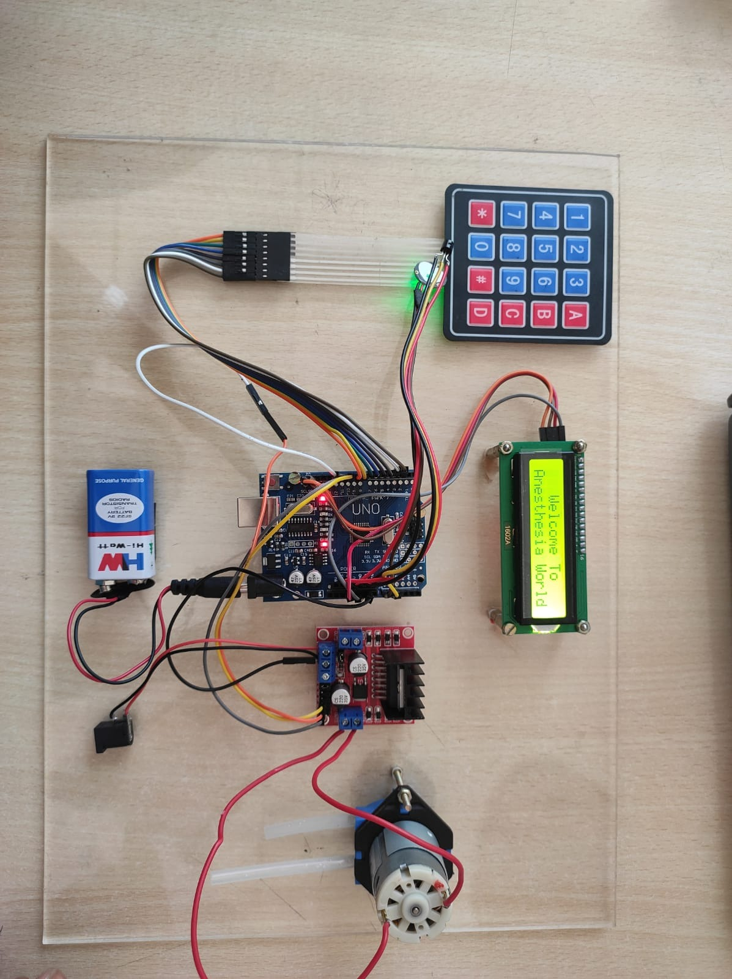
Project Implementation

Slide 12
Components Lists
For this project we have used different components to continuously track down the health of the patient. Some of these components are-
Temperature Sensor
Heartbeat/Pulse Sensor
Liquid Crystal Display (16*2) *I2C-Inter-Integrated Circuit
Arduino UNO
Keypad (4*4)
Peristaltic Motor, and Motor drive(l298)

Slide 13
DATA SETS
Name | Age | Gender | Temperature | Pulse Rate | Type of Surgery | Accu Amt Of Anesthesia | Approx Amt. Of Anesthesia
Arun | 19 | Male | 49.80 | 71 | Wisdom Tooth | 2ml | 1.8ml
Ankith | 30 | Male | 50.78 | 73 | Kidney Stone Surgery | 4ml (2+2) | 3ml
Anuradha | 22 | Female | 36 | 72 | Gall Stone | 1.5ml | 1ml
Bharath | 45 | Male | 34 | 50 | Heart Hole Surgery | 3ml | 1.8ml
Chinmay | 32 | Female | 43 | 70 | Appendix | 6ml (2+2+2) | 4.2ml
Dhanya | 45 | Female | 51 | 62 | Spinal Cord | 5.4ml (1.8*3) | 3.1ml
Dhanish | 31 | Male | 36 | 72 | Joint Replacement | 7 stages(66.5) | 50.2

Slide 14
DATASETS
Name | Age | Gender | Temp | Pulse Rate | Type Of Surgery | Accurate | Approximate
Gagana | 34 | Female | 51 | 77 | Heart Bypass | 5ml | 4ml
Harini | 45 | Female | 56 | 73 | C-section | 10ml (2+2+2+2+2) | 8ml
Kumar | 33 | Male | 52 | 72 | Laser Treatement(Eye Surgery) | 2ml | 1.5ml
Ashrith | 45 | Male | 53 | 74 | Nose Surgery | 3ml | 1.8ml

Slide 15
OUTPUT(Till Date)
Hardware components such as pulse sensor, temperature sensor, motor drive and persitalitc pump, I2C with lcd and keypad are connected to the Arduino
Keypad (Pin number from 1-8) is connected to Arduino(Pin number from 2-9)
All the connections are made according to the requirements
Arduino Code has been written and dumped into the Arduino and thus,
We get the output in LCD,
Partial Output:
The output is displayed in the LCD according to the patient’s condition, right now we will be showing how does the hardware work, and later we will upload the machine learning code along with the data sets and thus based on the given conditions, the output is displayed in the LCD.

Slide 16
CONCLUSION AND FUTURE SCOPE
Microcontroller is made use of to perform anesthesia injecting operation, where the quantity to be injected and the time at which the drug should be injected is provided.
The Microcontroller displays the quantity to be injected and the time in the display device. Syringe infusion pump is mechanically connected to the motor.
The stepper motor is used to control the forward and backward movement of the piston of the syringe.
The Syringe Infusion pump will injects uniform flow of anesthesia
Advantages of using the proposed system are physical presence of anesthetist is not always required, the required level of anesthesia is exactly calculated and administered so that future side effects due to variations in anesthesia levels are eliminated.
IR detector is included in the present system for monitoring the total anesthesia level throughout surgery period.

Slide 17
REFERENCES
“Automatic Anesthesia Control System” by Shelishiyah Raymond, Susmitha Edagottu, Lasngewhun Mawblei, Minhajul Ahmed (IEEE-2021) (Seventh International conference on Bio Signals, Images, and Instrumentation)
“Arduino based Automated Dosage Prescriptor using Load Cell” by A.Rasheedha, K.Srinathi, T.Sivalavanya R.R.Monesha, S.Nithin (IEEE-2020) (Fourth International Conference on Electronics, Communication and Aerospace Technology)
“Measurement of temperature and relative humidity in exhaled breath, Sensors and Actuators” by Elias Mansour, Rotem Vishinkin, Stephane Rehet, Walaa Saliba, Falk Fish, Patrice Sarfati, Hossam Haick (IEEE-2020) (Seventh International Conference on Electronics, Communication and Aerospace Technology)
“Robust Predictive Control Strategy Applied for Propofol Dosing Using BIS as a Controlled Variable During Anesthesia” by Clara M. Ionescu, Robin De Keyser, Bismark Claure Torrico, Tom De Smet, Michel MRF Struys, and Julio E. Normey-Rico (IEEE Transactions on biomedical engineering,-2019)
“R&D and Application of the Information Management &Quality Control System Softare for Anaesthesia Department” , by Zhongliang Zhu, Hongguang Bao, Hongwei Shi, Lei Xu (Second International Conference on Information and Computing Science-2018)
Prashanth C, Mohammed Salman, Rohan KR, Govinda Raju M & Roopa J, “Computerized Anesthesia Infusion System International Journal of Electrical, Electronics and Computer Systems” (IJEECS) 2018
Durgadevi S, Anbananthi Embedded System: “Patient Life Secure System Based On Microcontroller” International Journal for Advance Research in Engineering and Technology, 2018
Hanumant R.Vani , Pratik V, Makh, Mohanish & Chandurkar “Anesthesia Regularization using Heart Beat Sensor” International Journal Of Engineering, Education And Technology (ARDIJEET) 2017
“Automatic anesthesia regularization system (AARS) with patient monitoring modules” May 2018 International Journal of Engineering & Technology

